Slide 1
Fuzz Testing – Create Test
AVCDL-Implementation-10.1.2
Charles Wilson
Staff Product Cybersecurity Architect
version 3
2026-06-10
Notes:
Script:
I'm Charles Wilson, staff product cybersecurity architect at Torc Robotics.
This presentation will cover the Fuzz Testing test creation activity.

Slide 2
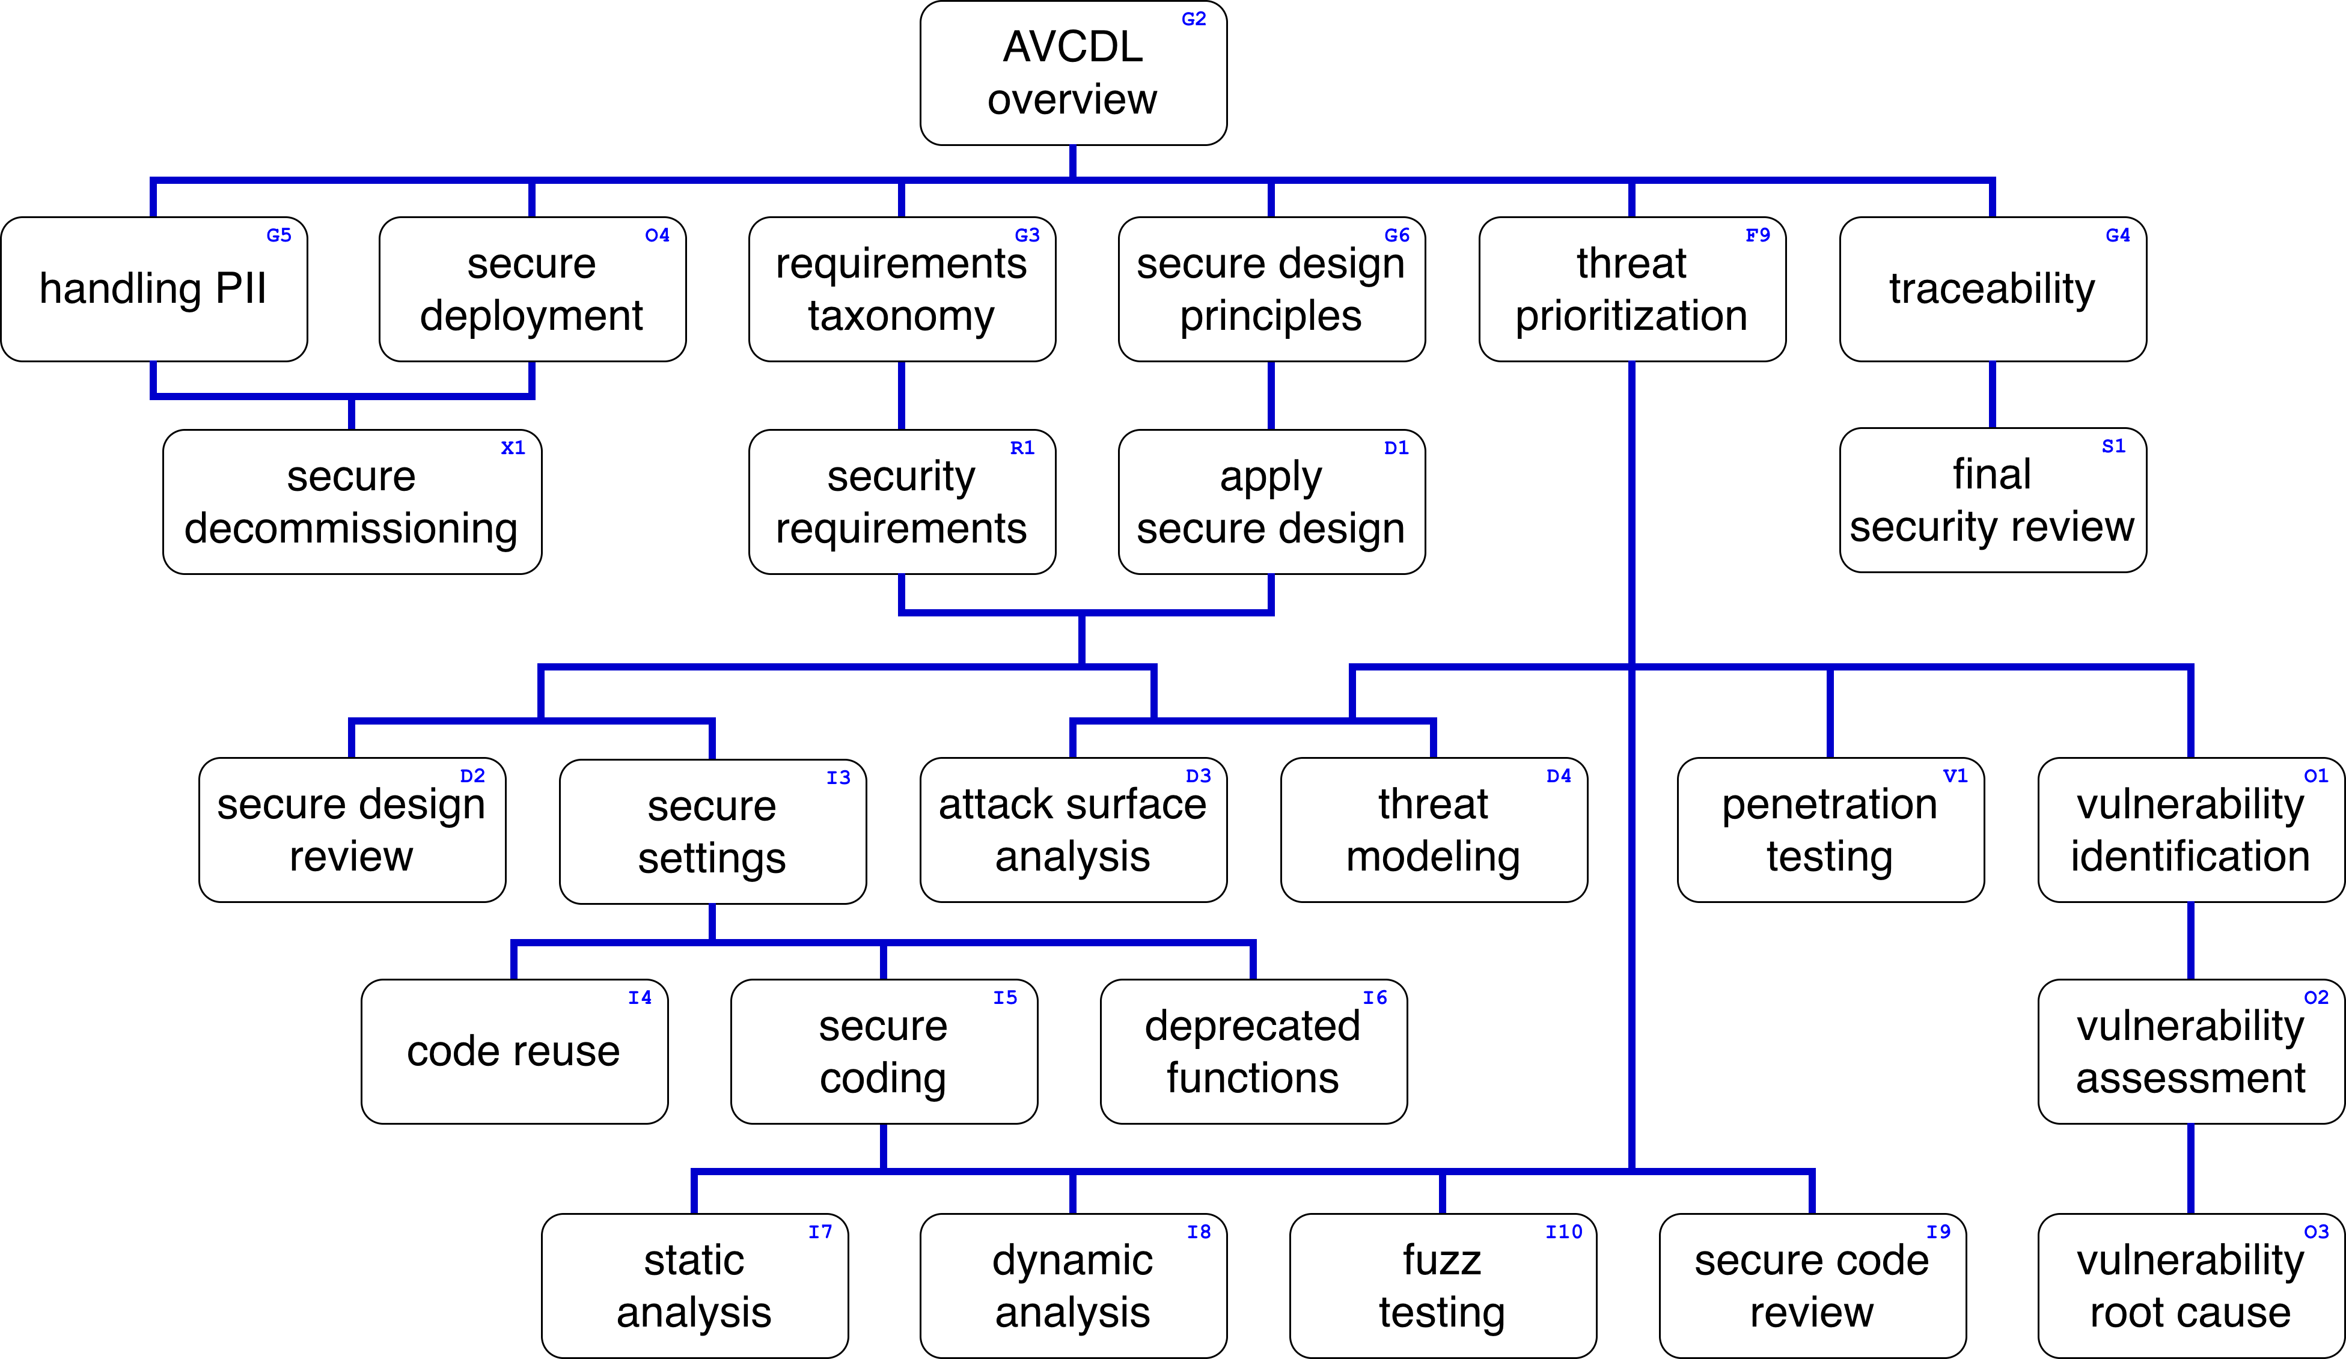
Training Path
Notes:
Script:
This diagram shows the overall AVCDL training path.
If you're taking this training, it's assumed that you've already completed the AVCDL Overview training,
and additionally, that you've completed the
Requirements Taxonomy
Security Requirements
Secure Design Principles
Apply Secure Design
Threat Prioritization
Secure Settings
Secure Coding
Fuzz Testing Overview
and
Fuzz Testing Establish Settings
trainings.
This training will cover Fuzz Test Creation.

Slide 3
Workflow
Notes:
Script:
Before getting into test creation, let's briefly review where it fits, in the overall fuzz testing process.

Slide 4
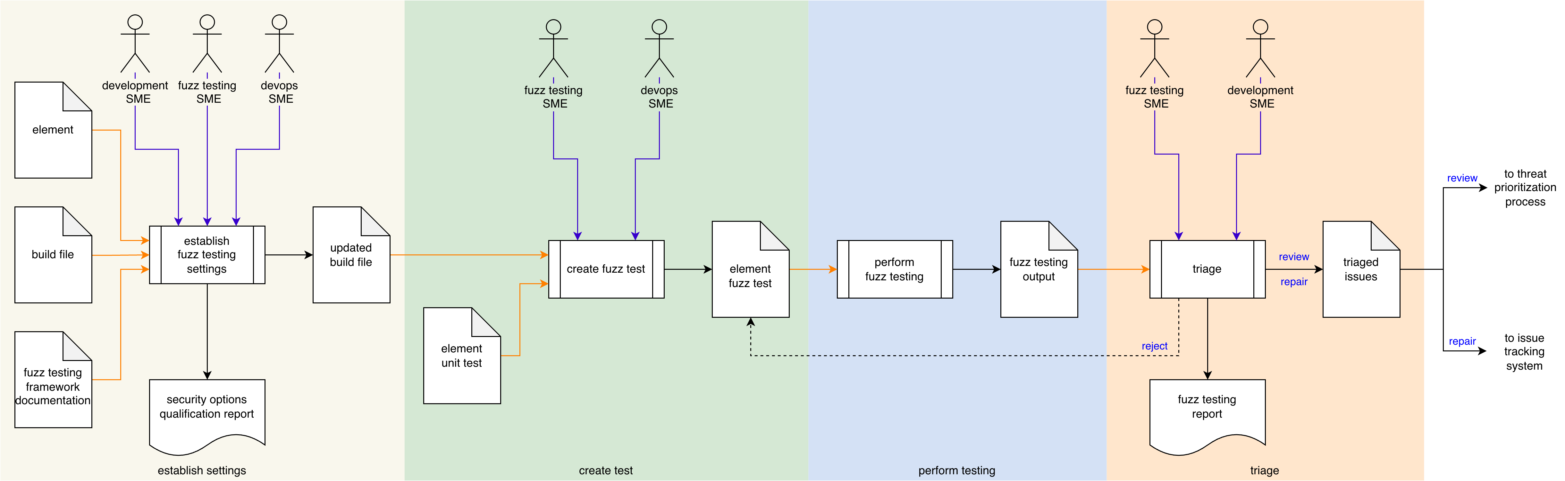
Process Workflow
Notes:
Script:
Here's the fuzz testing process which we previously covered in the Fuzz Testing Overview training.
[break]
Our focus for this training will be on the second activity, that of test creation.

Slide 5
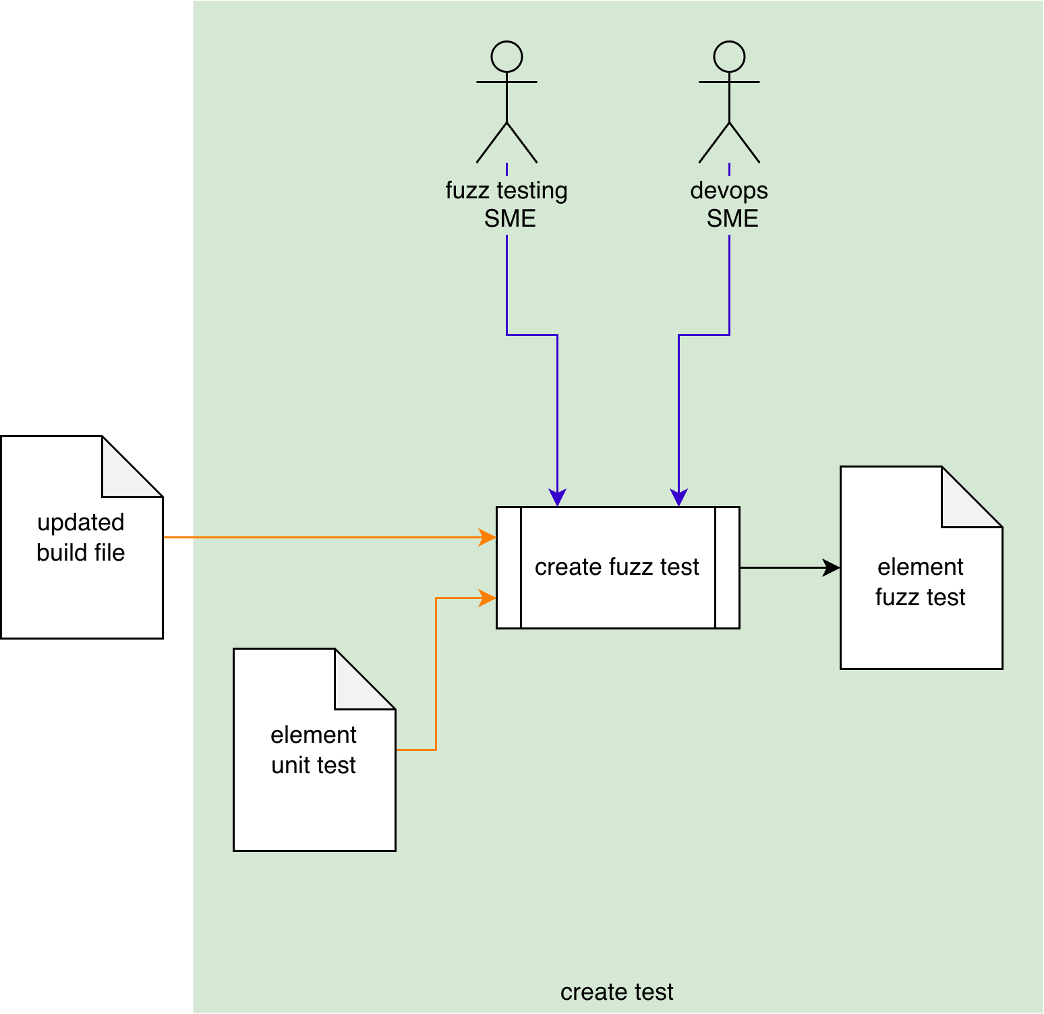
Process Workflow
Notes:
Script:
Here's the fuzz testing process which we previously covered in the Fuzz Testing Overview training.
[break]
Our focus for this training will be on the second activity, that of test creation.

Slide 6
Create Test Activity
Notes:
Script:
In the create test activity,
[pause]
the fuzz testing SME and
[pause]
the DevOps SME, take
[pause]
the updated build file and
[pause]
the element unit test
[pause]
and using them, create
[pause]
an element fuzz test.
[break]
Some high level observations about this activity.
[pause]
First, fuzz testing should only be done in the context of test builds, not production builds.
[pause]
Second, the activity itself may be performed without the participation of the DevOps SME.
This is all about how the build system is managed.
[pause]
Third, the unit test for the element may not exist.
This is a problem because of the way that fuzz tests are created.
The absence of a unit test makes the fuzz test creation that much more difficult.
[pause]
Finally, when creating a test to be run in the context of a CI/CD system, you have to keep in mind that there may be constraints in terms of timing and resources.
And so, as discussed in the established settings activity, we need to pre-flight the activity in order to get a sense of what impact it's going to have.
This may require the participation of the DevOps SME in order to make adjustments to the CI/CD system, if we find that the test is going to exceed its resource budget.

Slide 7
Create Test Activity (overlay)
may be optional
only test builds
may not exist
preflight
Notes:
Script:
overlay

Slide 8
Approach
Notes:
Script:
Now let's turn our attention to how we're going to approach fuzz test creation.

Slide 9
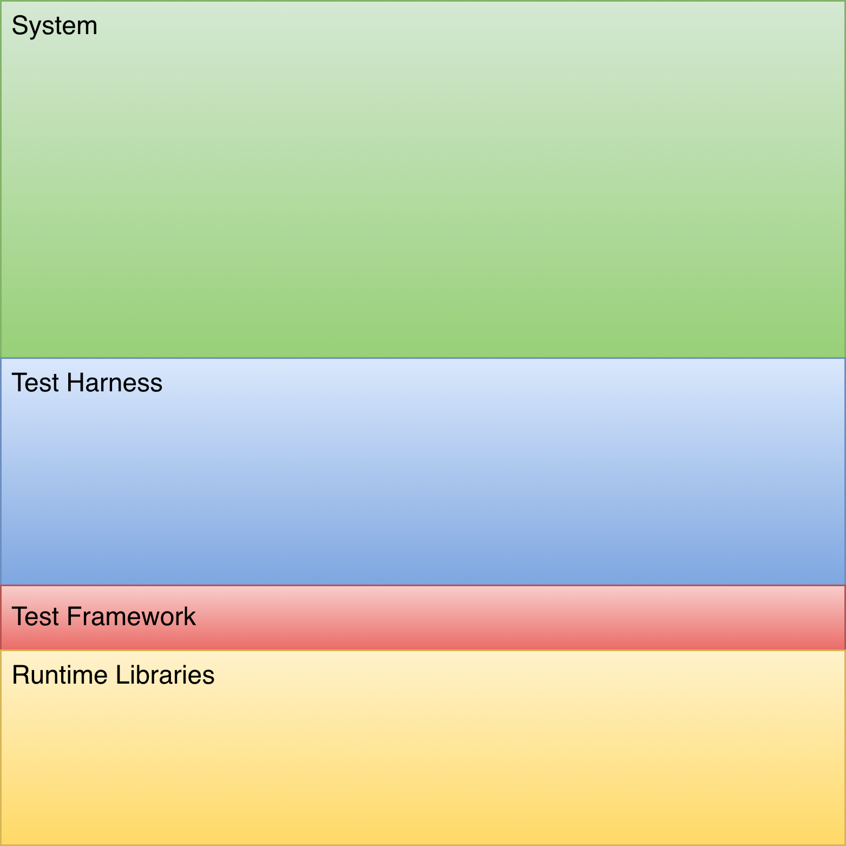
Methodology
Notes:
Script:
In order to effectively undertake fuzz test creation, it's critical to understand what's going on behind the scenes.
So, let's take a look and see what we're working with.
First, we're going to start with
[pause]
the system, which is simply the totality of the elements comprising the product.
We're not going to perform fuzz testing at the system level.
It's too large a scope to work with on a practical level in terms of instrumentation.
It will take far too long to run.
Finally, there will be too many issues to process.
And so, we limit the scope of fuzz testing to individual
[pause]
elements.
Since fuzz tests operate at the function interface level, we want to apply it to the smallest operational context within the element.
[pause]
The way we think about fuzz testing isn't that much different from how we think about performing unit testing, which is why we take unit tests and extend them.
So, just like our unit test approach, we have
[pause]
a test harness that we build atop
[pause]
a test framework.
Finally, we have
[pause]
the fuzz test itself.
Now, if we were just doing a unit test, this would be where we'd stop.
We would take known inputs, feed them into the function, take the output, and compare them against expected output.
Fuzz testing, on the other hand, is an activity more akin to dynamic analysis as we have a strong possibility of generating either a crash or anomalous behavior such as memory corruption.
Because of this, the fuzz testing activity needs to be able to deal with both of these in order to be effective.
Crashing is something that's managed either in the test harness or test framework itself.
Handling anomalous behavior requires help from dynamic analysis tooling.
[pause]
This brings in consideration of
[pause]
the runtime libraries.
Specifically,
[pause]
the dynamic analysis instrumented runtime libraries.
This also requires that we have
[pause]
instrumentation of the element under consideration in order to take advantage of the support that's given us by the instrumented dynamic analysis tooling to detect anomalous behavior.
For more information on this, refer to the dynamic analysis process materials.

Slide 10
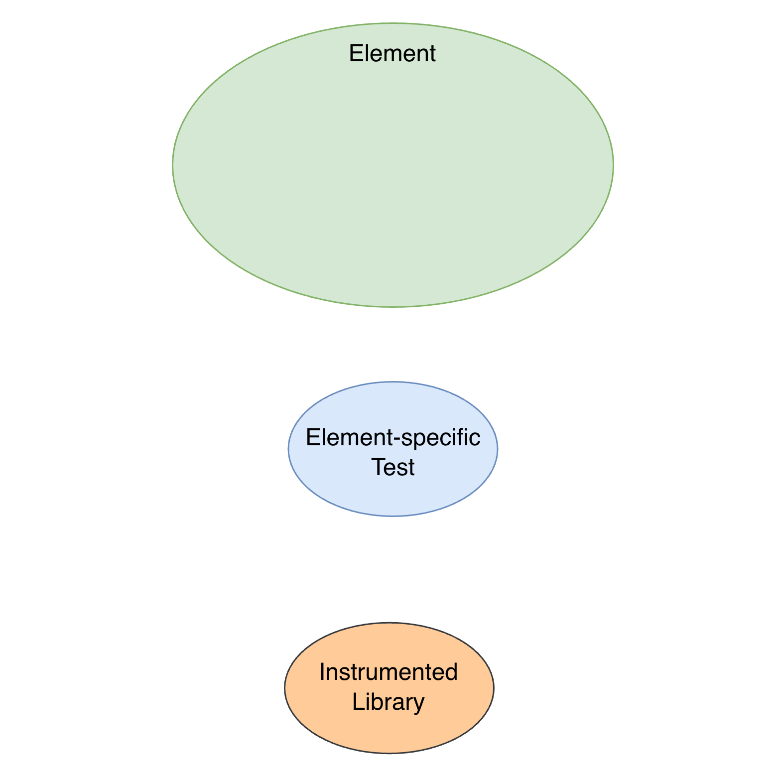
Methodology (overlay 1)
Notes:
Script:
overlay

Slide 11
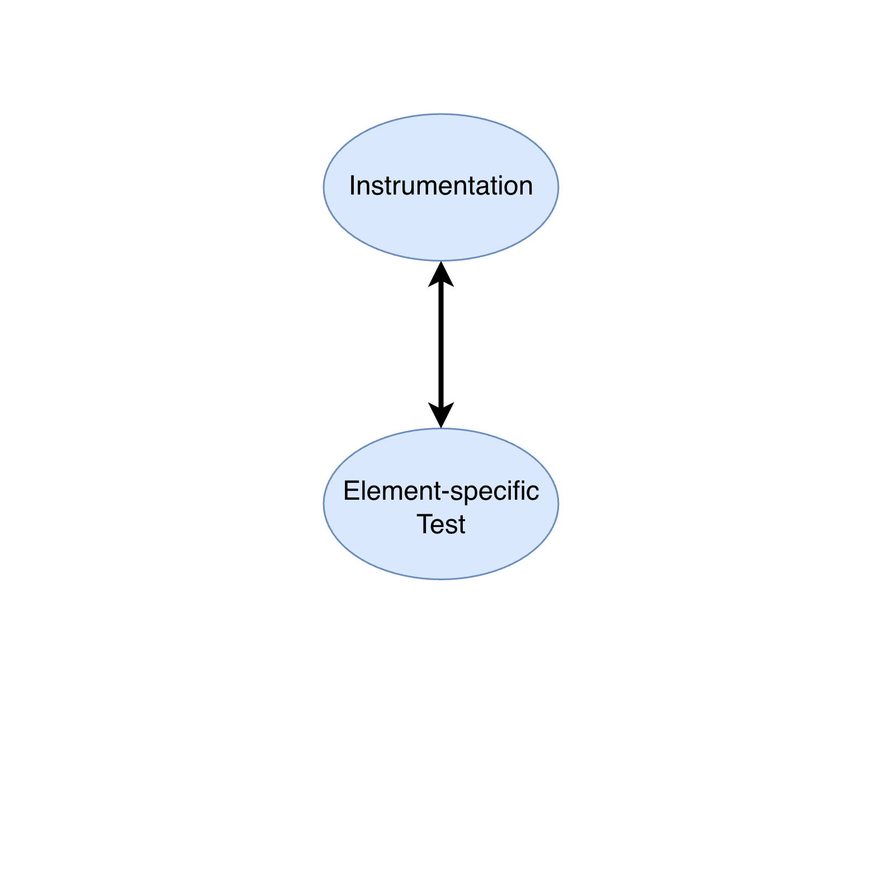
Methodology (overlay 2)
Notes:
Script:
overlay

Slide 12
Unit Test ➔ Fuzz Test
Notes:
Script:
Now, let's talk about how we go from a unit test to a fuzz test.

Slide 13
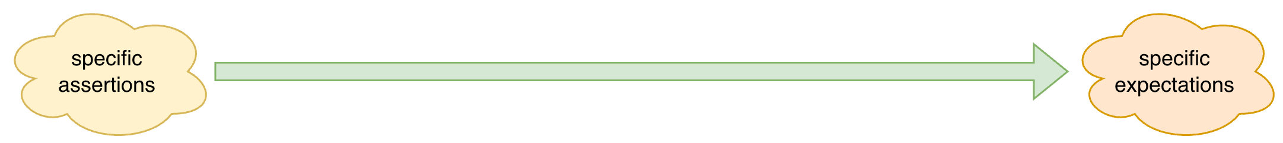
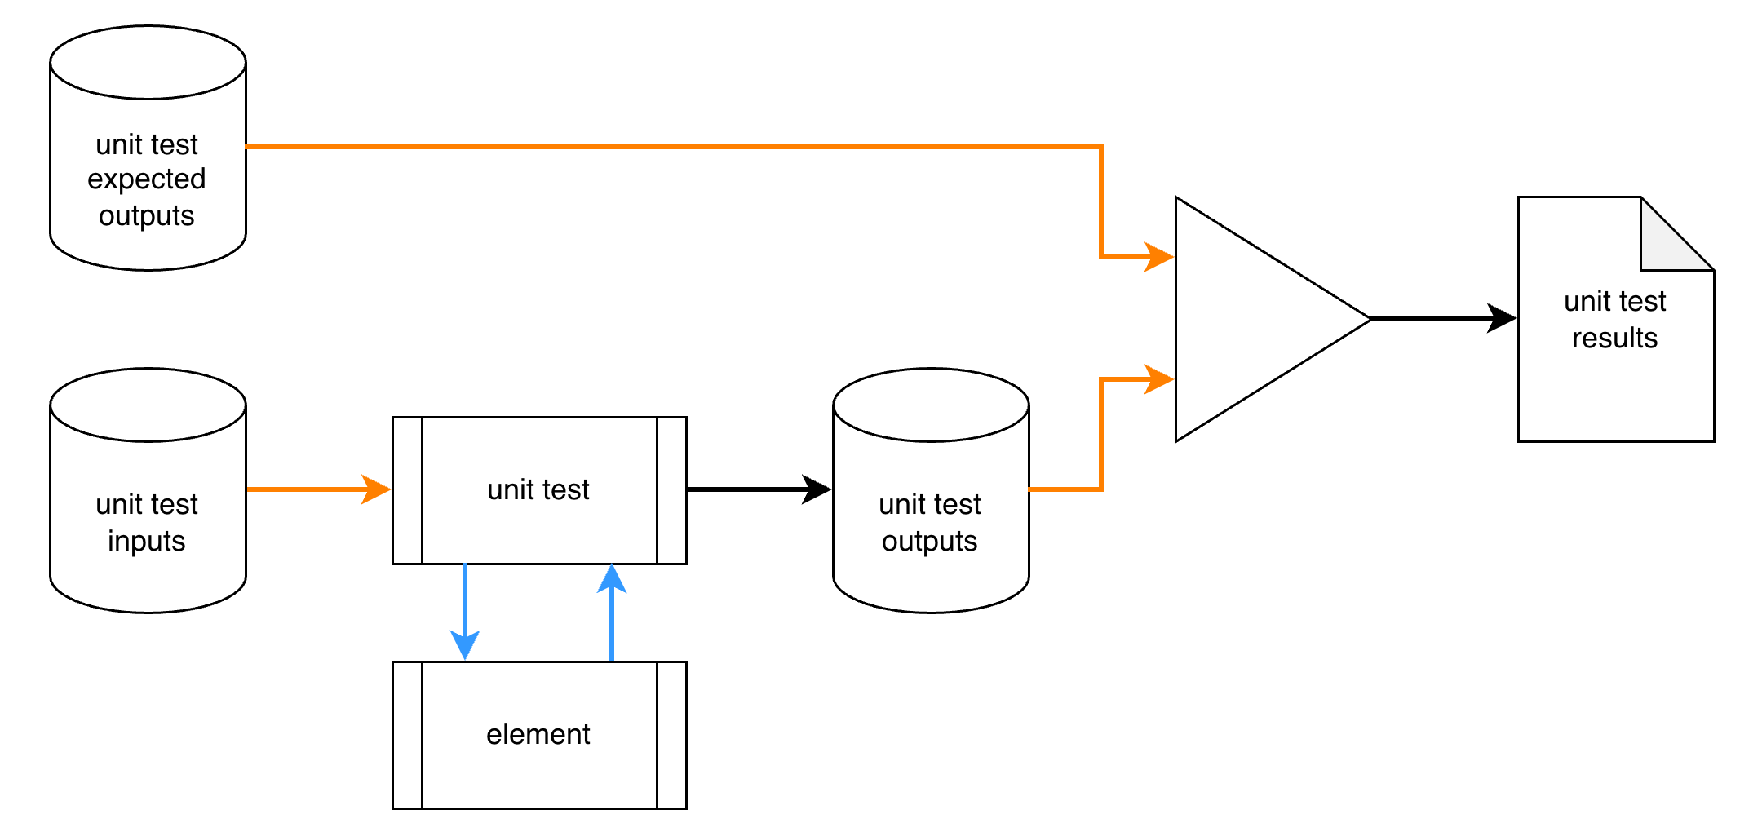
Unit Test
Notes:
Script:
With the unit test, we come in with a set of
[pause]
specific assertions.
During the course of the test, we want to get to a set of
[pause]
specific expectations.
So, what does this look like in practice?
We take
[pause]
the element under consideration and create
[pause]
a unit test for it which exercises the element’s interface.
To do this, we're going to have to create
[pause]
some inputs for it.
The expectation is that the element is going to respond to the inputs, and generate
[pause]
outputs.
Additionally, we need to supply
[pause]
expected outputs.
We're going to take both the
[pause]
expected outputs, and
[pause]
actual outputs,
[pause]
compare them, and produce
[pause]
a set of results.
Now, as stated, the unit test deals with specific assertions and specific expectations.
We expect that for a particular input, we're going to get a particular output.
If we don't, then the element has not been constructed properly.
This is the typical way that development would approach this.
Now, let's look at how we're going to modify this approach to create a fuzz test.

Slide 14
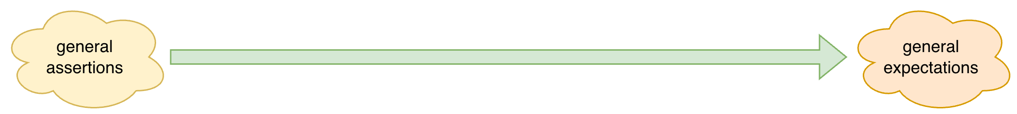
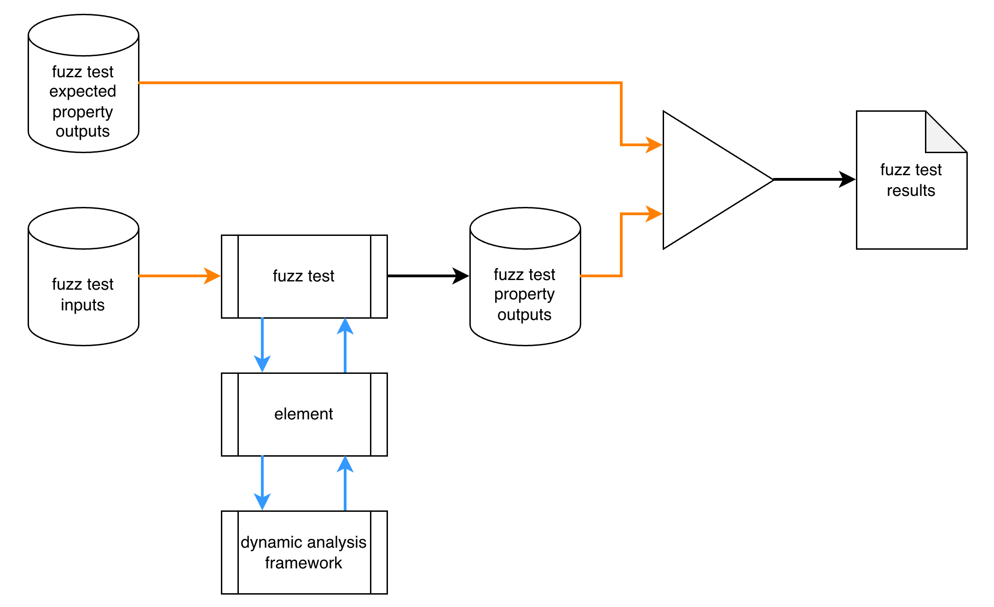
Fuzz Test
Notes:
Script:
Unlike the unit test where we have specific assertions and expectations, with fuzz tests we have
[pause]
general assertions and
[pause]
general expectations, where we're
[pause]
going from one to the other.
The workflow for this is similar to that of unit testing.
We have
[pause]
• the element
• the fuzz test interfacing with the element
and
• fuzz test inputs
[pause]
Unlike unit test inputs, fuzz test inputs are randomly generated.
The randomness is constrained within the context of a corpus of valid inputs.
[pause]
We have the expectation that there will be produced a set of
[pause]
fuzz test outputs.
What differs is that the fuzz tests are property-based rather than value-based.
[pause]
Instead of providing a specific input to a function and expecting a specific output, with fuzz tests, for any given set of inputs, we expect that the output will have specific characteristics.
The specifics of how property-based testing works is outside the scope of this training.
Links to a video and blog post, both of which provide a good explanation, are included in the references at the end of the presentation.
[pause]
With fuzz testing may also have
[pause]
expected outputs which are also property-based.
When we have expected outputs, we will
[pause]
compare those with the outputs from the fuzz test.
The outcome of those comparisons go into
[pause]
the fuzz test results.
[pause]
Additionally, as mentioned earlier, we don't know that we're going to get a particular behavior from a fuzz test.
We may get an expected return value from the element.
We may get an unexpected return value.
We may get anomalous behavior.
Or we may get a crash.
In the case of a crash, the fuzz test framework should be intercepting that and processing it appropriately.
If we run the test and nothing appears to be out of the ordinary, that doesn't mean that nothing bad has happened.
This is why it is recommended to use
[pause]
a dynamic analysis framework to augment fuzz testing.
That framework is used to detect anomalous behavior.
It’s this combination of constrained randomized inputs, property focus, and dynamic analysis support that elevates unit testing to fuzz testing.

Slide 15
Fuzz Testing Considerations
Notes:
Script:
Now let's look at some points to consider when we're creating fuzz tests.

Slide 16
Considerations
Unit tests
Detection limitations
Cybersecurity relevancy
Concurrency
Test scope
Automation
Notes:
Script:
It's recommended that if you are creating fuzz tests that you take time and review the considerations that are presented in the previous training on establishing settings, and also the underlying material from the secure settings process.
Both of those apply and are a good general rules of thumb whenever modifying the CI/CD pipeline.
[pause]
Within the context of creating fuzz tests, the first consideration is that of
[pause]
unit tests.
Because fuzz testing extends the concept of unit testing, it is presumed that a unit test exists for the functions within the element under consideration.
If there isn't a unit test for the function, although it is possible to construct a fuzz test from the function’s documentation, this isn’t recommended.
It's highly recommended that cybersecurity fuzz tests only be created for those elements which development has already provided unit tests, because these act as baselines for expected behavior.
The amount of time it would take to essentially build a unit test and then build a fuzz test atop it isn’t a productive use of time for a size-limited cybersecurity team.
[pause]
Next, keep in mind that there are going to be limitations as to what fuzz testing is going to be able to detect on its own.
Fuzz tests are not guaranteed to generate crashing behavior.
They're also not guaranteed to generate behavior detectable by dynamic analysis.
Even if a fuzz test generates an anomaly, that doesn't mean that you can detect it.
And just because you run a fuzz test and it doesn't crash or it returns the results that you expected, doesn't indicate that you have the absence of a vulnerability.
It's strongly recommended that when you're doing fuzz testing, you do it in conjunction with dynamic analysis tooling to be able to catch as much anomalous behavior as possible.
Also, keep in mind that fuzz testing should not be considered a replacement for more extensive testing of the element through unit testing, static analysis, and other approaches.
[pause]
The next thing to consider is the cybersecurity relevancy.
This is because since we're focusing here on cybersecurity,
and in order to get as much benefit out of our effort as we can,
we want to focus on those areas which deal with data and behaviors which are cybersecurity relevant.
Otherwise, this activity is just normal development QA, which is outside the scope of the product cybersecurity team.
Additionally, in the context of fuzz testing, when we're talking about cybersecurity relevancy, we're talking about relevancy beyond just the general element-level.
We're talking about the cybersecurity relevancy of functions within the element under consideration that has itself been determined to be cybersecurity relevant.
Just because an element is cybersecurity relevant doesn't mean that every function is going to be dealing with things which are also cybersecurity relevant.
[pause]
Next we have concurrency.
With the advances in sophistication of CPUs now available, fuzz test concurrency becomes a possibility.
When you a fuzz testing framework that supports this, you need to give special attention to the resource footprint impact.
Additionally, if you can configure the concurrency of the fuzz testing framework, make sure it’s not set to absorb all the CPU cores or set to use only one.
Choose settings appropriate to your use case.
Usually the CI/CD pipeline will be running on hardware which is far better resourced than either a developer's machine or the target device you're going to be deploying it on, so take advantage when you have those resources available.
[pause]
Next we have the test scope.
We want to scope the fuzz test as minimally as possible in order to allow us to be able to reproduce and resolve issues efficiently.
It’s also useful to limit the number of function parameters changing within a given test.
[pause]
Finally, we have automation.
If you have an updated build file with the fuzz testing and dynamic analysis frameworks available
and the documentation of the element that fuzz testing is to be applied to
and the documentation of the element function interfaces
and finally, documentation on the element’s behaviors,
it may well be feasible to apply automation capable of using this information to generate fuzz tests.
This is an evolving area of work.
The specifics of how this type of automation works,
how you would integrate it,
and what your options are,
fall outside the scope of the AVCDL.

Slide 17
Recap
Notes:
Script:
That covers our treatment of the test creation activity within the fuzz testing process.
Now let's look at some takeaways.

Slide 18
Summary
Concentrate on the cybersecurity-relevant functions
Don’t replicate analysis performed by other tools
Be mindful of analysis constraints and impacts
Notes:
Script:
When creating fuzz tests
[pause]
concentrate on cybersecurity-relevant functions within the element under consideration.
As with all tooling,
[pause]
don’t replicate the analysis that's performed by other tools.
Finally,
[pause]
be mindful of the analysis constraints and impacts.

Slide 19
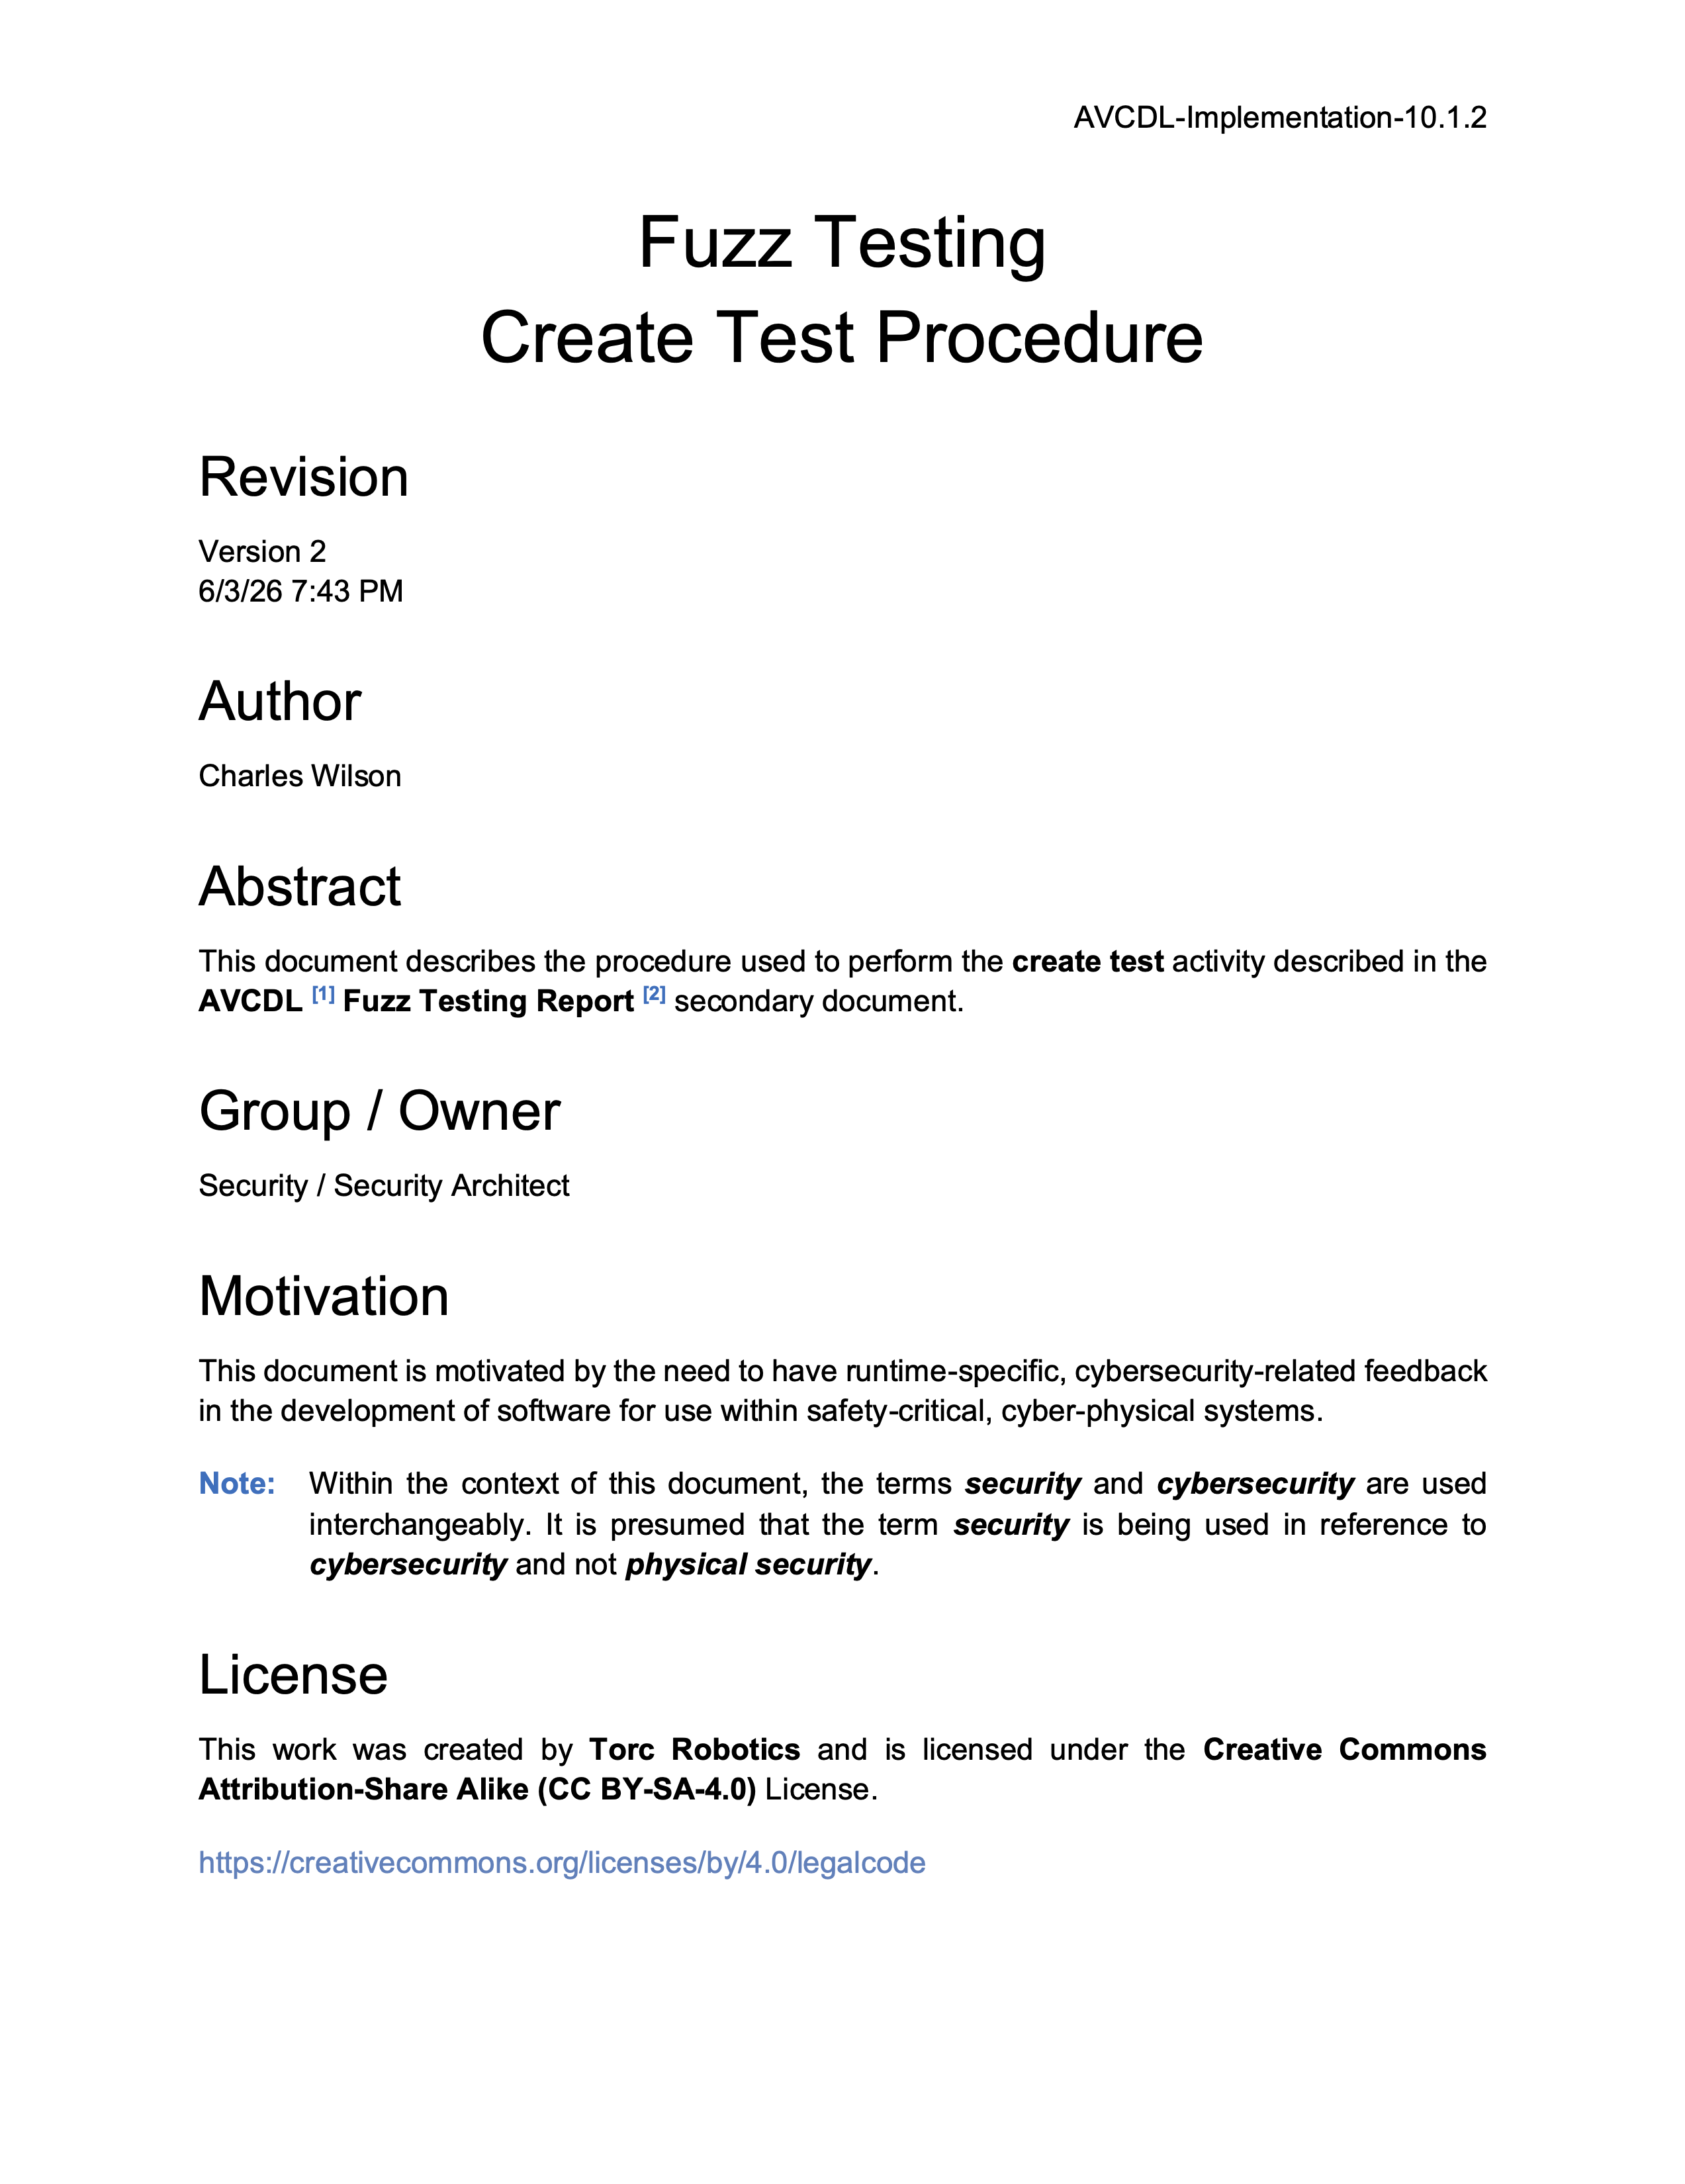
Further Reading
Notes:
Script:
For additional information and to get a more in-depth set of references, the Fuzz Testing – Create Test Procedure tertiary document is available in the AVCDL GitHub repository.

Slide 20
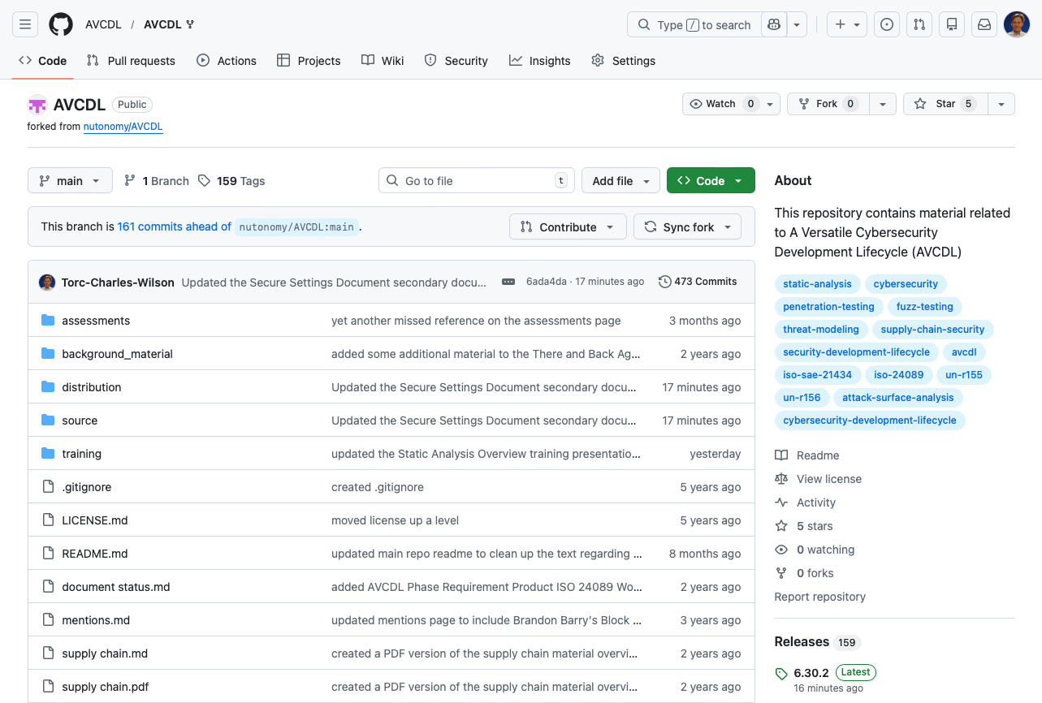
AVCDL on GitHub
https://github.com/AVCDL/AVCDL
Notes:
Script:
All AVCDL materials, both in source and distribution forms, are available on our GitHub site, as shown here.
Because of the size of the repository, it's recommended that you either clone the repository or download a ZIP archive of it, if you're not familiar with using git.
Instructions for downloading a ZIP archive are linked to on the repository’s front page.

Slide 21
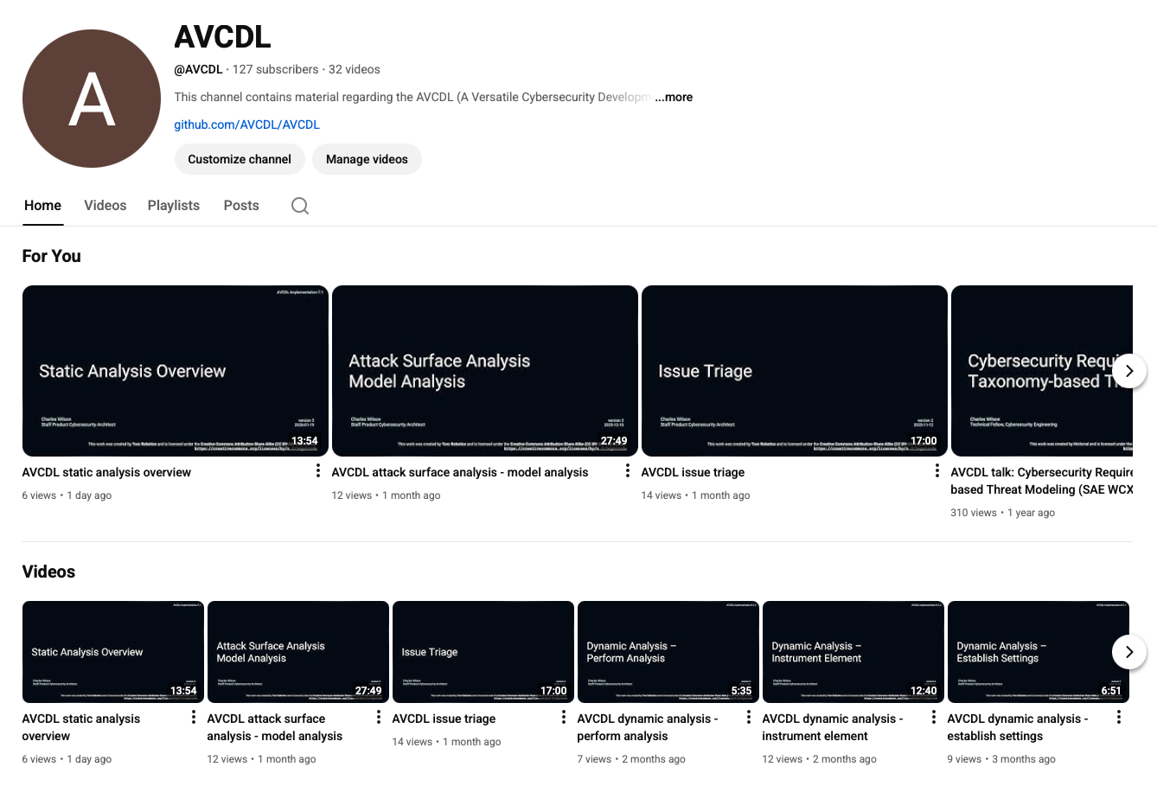
AVCDL on YouTube
https://youtube.com/@AVCDL
Notes:
Script:
Videos covering various aspects of the AVCDL are available on our YouTube channel, as shown here.
It's important to note that all AVCDL materials with the exception of the introductory blog posts are intended for product cybersecurity engineering practitioners.

Slide 22
Next Steps
Notes:
Script:
With this training complete, if you’ve completed the other trainings covering the Fuzz Testing process activities, you can proceed to the other trainings at this level, these include:
Static Analysis
Dynamic Analysis
and
Secure Code Review

Slide 23
References
AVCDL primary document
Fuzz Testing Report (AVCDL secondary document)
Fuzz Testing Establish Settings Procedure (AVCDL tertiary document)
Fuzz Testing Create Test Procedure (AVCDL tertiary document)
Dynamic Analysis Report (AVCDL secondary document)
Secure Settings Document (AVCDL secondary document)
Element Cybersecurity Relevancy (AVCDL secondary document)
An introduction to property based testing
https://fsharpforfunandprofit.com/pbt/
The lazy programmer's guide to writing 1000's of tests
https://youtu.be/IYzDFHx6QPY?si=p0v9wXF5wS4B2U-0
Notes:
Script:
Here are the references to the source material used in the creation of this presentation.
They'll also be included in the video description.
Additionally, this presentation’s source material will be provided on the AVCDL GitHub repository.

